Slide 1






Project:
Internship IU
created by Trần Hải Nam-ITITIU19161

Slide 2
Table of content
1
2
3
Introduction
Analysis
Deploy and demo

Slide 3
Introduction

Slide 4
Problem of Student
Difficulty in finding work with reputable companies
Difficulty in obtaining information about the internship process
Difficulty finding report templates and submitting reports to teachers
It's hard not knowing how to write a cv and how to submit it

Slide 5
Problem of Teacher
Takes time in compiling student information for grading and reporting
Difficulty in student management and student support

Slide 6
Anlysis

Slide 7
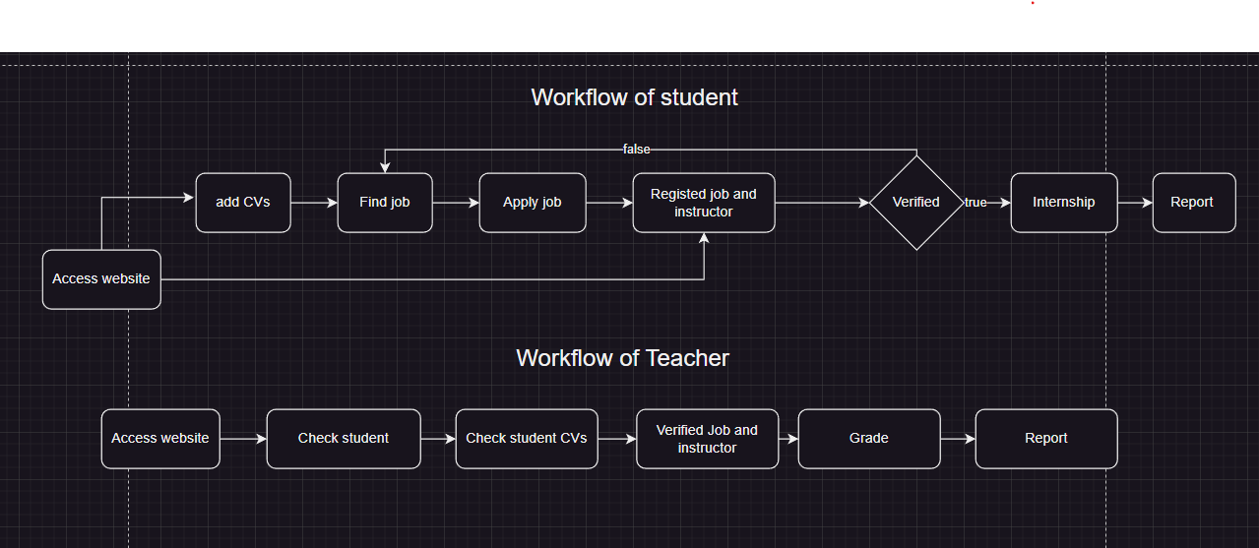
Workflow

Slide 8
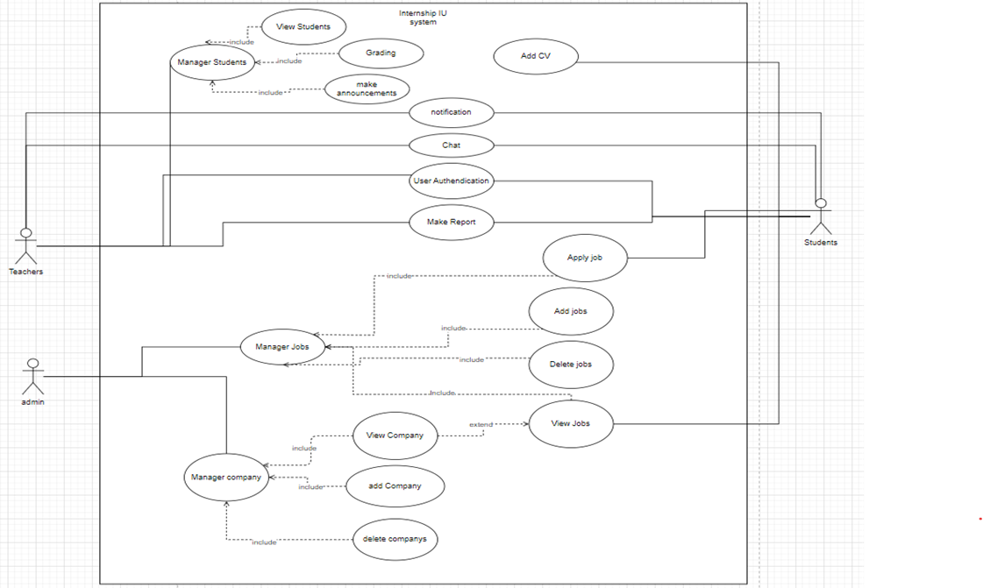
Usecase diagram

Slide 9
Deploy and Demo

Slide 10


Technical
Reactjs
Mui Material UI

Slide 11
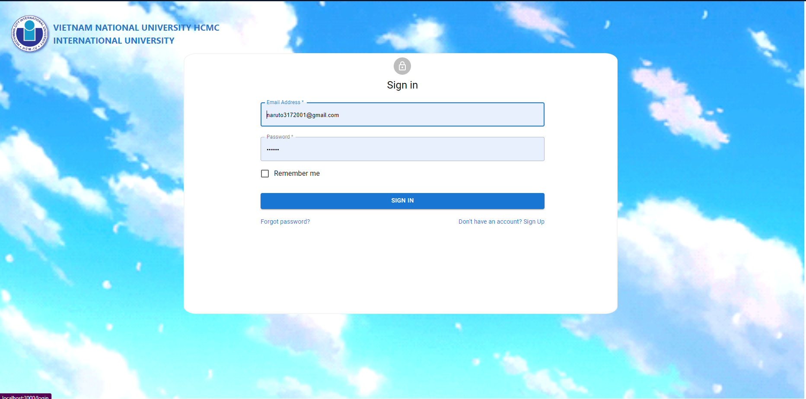
Demo

